Slide 1
How to NOT fail in Social Computing for Business
Alina Fu, SharePoint Product Manager
Ludovic Fourrage, PKS Group Program Manager
Microsoft Corporation

Slide 2
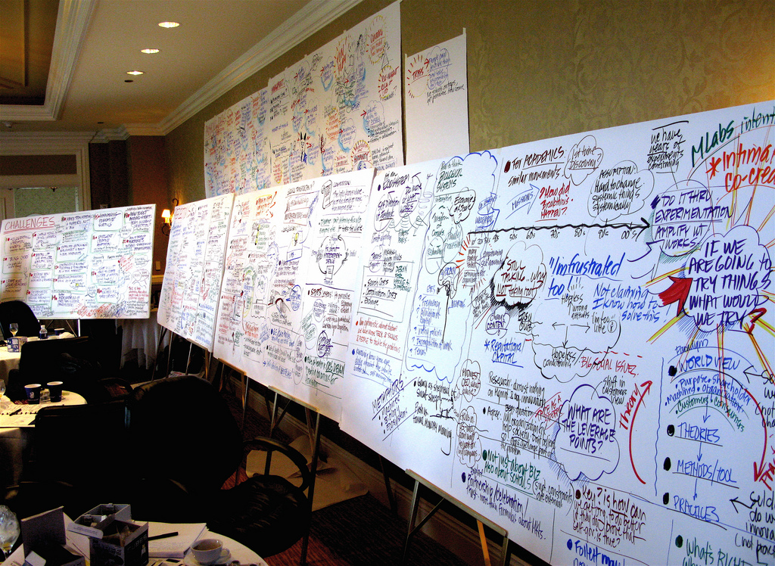
Notes:
From Flickr: Stream of Consciousness

Slide 3
Main Drivers For Social Computing
Drive collaboration & social interaction
Capture & share tacit knowledge
Capture the “wisdom of the masses” via social feedback
Discover content in new ways
Build a sense of connection to the company
Notes:
Here are 5 main business drivers many customers face for social computing.
Drive collaboration and social interaction across geographic and organizational boundaries
Break out of the “silo” effect
2. Transfer tacit knowledge into information and knowledge management solutions
Document and capture tacit knowledge into something tangible
3. Enhance discoverability of resources through new ways of communication
Uncover content from different channels
4. Capture the “wisdom of the masses” by gathering social feedback
Invite diversity of opinions and crowd intelligence
5. Establish sense of belonging and connection to the company
Provide new hires with the tools to improve their onboarding experience

Slide 4

Common Technical Challenges
Provide consumer-like capabilities
Integrate with existing infrastructure
Comply with corporate security & privacy
Support tools affordably and efficiently
Notes:
IT faces challenges to:
Provide consumer-like capabilities
Consumers are bringing these tools into the workplace
2. Integrate with existing infrastructure
Desire to minimize complexity and dependencies
3. Comply with corporate security & privacy
Follow the governance and compliance models
4. Support tools affordably and efficiently
Lower the overall costs of maintenance as much as possible

Slide 5
What is success for social computing?

Slide 6

First let’s define success…
User generated content
Mass collaboration
Real-time knowledge
Increased productivity
Intuitive user experience
Pervasive: whenever, wherever
Integrated with our way of work

Slide 7
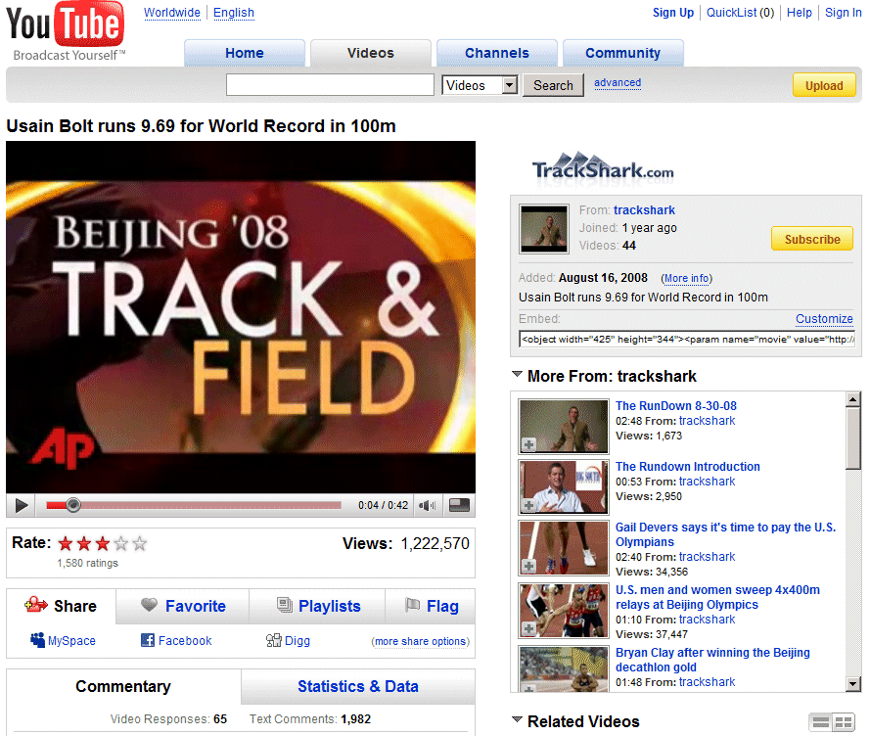
Notes:
YouTube example – note the number of Ratings versus the number of Views

Slide 8
Transposing this in the Enterprise
YouTube (year 2)
Enterprise X (year 2)
Audience size: 1.319 billion
Viewers: 79 Million
  6% total audience size
For one “successful” piece of content (1.22 M views)
  Viewers = 1.54% of total audience
  Rating = 0.13%
  Commenting = 0.16%
Audience size: 80,000
Viewers: 4,800 (6%)
For one “successful” piece of content:
  Viewers = 74
  Rating = 0
  Commenting = 1 (maybe)
Notes:
Why is this YouTube comparison relevant?
Shows typical user segmentation:
Creators
Contributors
Consumers
Shows typical content distribution:
Narrow
Longtail

Slide 9
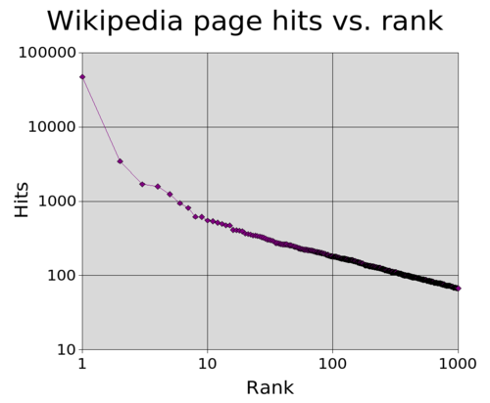
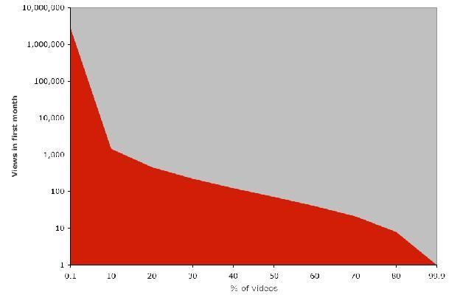
Content distribution
YouTube and Wikipedia
YouTube to Video Popularity Distribution
Power Law (80-20 rule)
Zipf Law
“We're Selling Ads Against 'Less Than 3%' Of Our Videos”
Notes:
It’s not just YouTube – Wikipedia shows the same characteristics of content distribution as well: Number of consumers >>> Number of contributors >> Number of creators

Slide 10
The Challenge
Increase 3C (creator, contributor, consumer) ratios by leaps and bounds
Wrong…
In the Enterprise…
Content creators
  = 1%?
Content contributors
  = 9%?
Content consumers
  = 90%?
Content creators
  = 0.1%
Content contributors
  = 0.3%
Content consumers
  = 99.6%
Good enough
  Achievable
Creator
Campaign
Too low
  Need more contributors
Contributor
Tools
Do we all believe this?
On the internet considering an audience…
That’s if they will come
  How many consumers do you want to reach?
Consumer
Campaign
Notes:
The Challenge is figuring out how to make social computing environments successful in the enterprise. We cannot simply transpose the percentages of consumer technologies into the enterprise and have it work just as successfully. Organizations must provide a Creator campaign, Contributor tools, and Consumer campaign to make their deployments effective.

Slide 11
Learning 2.0
Learning 2.0
Traditional Learning | Centrally developed or purchased courses
 | Learning segments lasting hours
 | Delivery via PC
 | Often just in case
 | Often compliance driven
 | Train on competencies and knowledge
User/Expert generated content + user ratings | = Learning 2.0
Segments consumable in minutes
Delivery via cell phones, Zunes, etc…
Just in time
More performance driven
Deliver knowledge at point of need
Notes:
E-Learning is a combination of traditional learning + social computing elements to create “Learning 2.0”
The Taylorism approach is good for some elements of training and learning (compliance…) but cannot capture the wealth of knowledge and information and make sense of it for the learner.

Slide 12
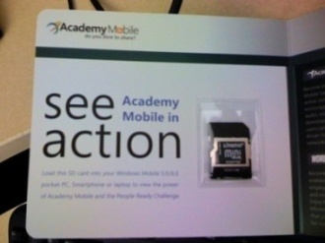

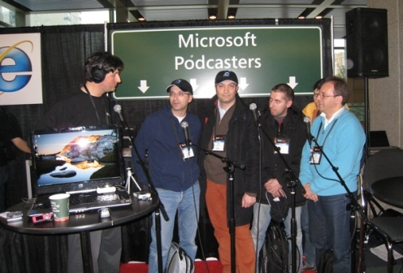
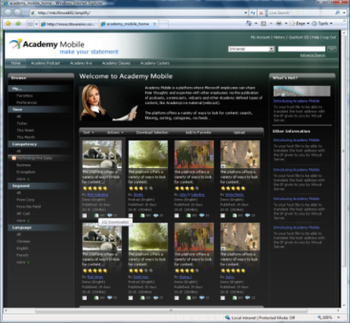
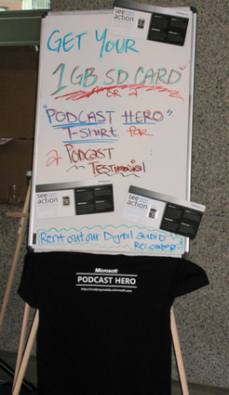
Microsoft Case Study:
Academy Mobile
Information about:
  Products
  Industry
  Competitors
  Selling techniques
Searchable by topic, presenter, workload, rating, etc.
Podcasts/videocasts developed by
  Product Teams,
  Experts,
  Sales force.
Virtual meetings captured, cataloged, indexed, converted to video, audio and PowerPoint formats
Online community and best practice sharing vehicle
22,000 internal users + 5,000 partners
Scaling to over 200 podcasts per month
Has significantly increased knowledge re products, competitors and sales best practices
Provides “voice of the field” for sales, product and learning leadership – immediate feedback
Notes:
Internal case study – Academy Mobile is a solution used by Microsoft for a social networking and podcasting platform.

Slide 13
Customer examples

Slide 14

British Telecom
Business Sponsor: Peter Butler, Head of Learning, BT Group
Learning and Development Vision:
  To weave learning into the fabric of the work environment so that employees do not have to remove themselves from their customers and responsibilities for long periods in order to learn and develop
Solution: Learning 2.0 via Podcasting Kit for SharePoint
Business Partner: Accenture

Slide 15
How did British Telecom NOT Fail?
Creating a business case
Establishing alignment to the business strategy and priorities
Securing executive business sponsorship and engagement
Working with Knowledge Management and Social Media “teams”
Conducting a proof of concept

Slide 16
Closing the Performance Gap
Knowledge Management
On The Job Learning
Desired Average
Performance
Knowledge
Training
Today’s Average Performance
Recruiting/Retention
Skills and
Competencies
Learning 2.0
Knowledge
Skills and
Competencies
Recognition/Rewards
Aptitude
Total Performance
Aptitude
Traditionally addressed by HR
Motivation
Motivation
Levers to Pull

Slide 17
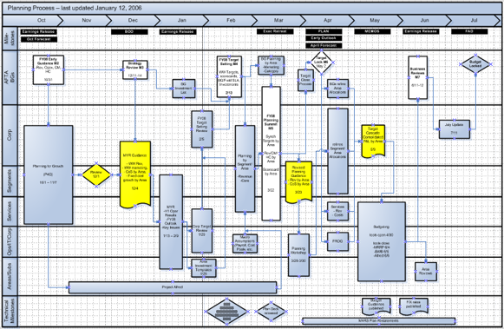
Planning for learning in most companies
Notes:
Typical Taylorism approach: there’s a process defined to build learning courses, a beginning and an end, milestones, established timeline etc…

Slide 18
Likely Outcome
Content Produced
Employee’s Experience
½ or full day courses:
  Expensive
  Few of them
One size fit all
Formally structured
Too little… too late
FRUSTRATION
“I wish I didn’t spend the whole day in this training… only 30 minutes was relevant to me”
“I don’t have time for this”
“I don’t want to learn how to use another tool”

Slide 19
British Telecom
Audience Strategy
In which line of business do you seat | Number of Podcasters
Group | 1
Design | 10
Retail | 6
Wholesale | 22
Operate | 13
Global Services | 6
What type of role are you in? | Number of Podcasters
Leadership | 5
Service | 7
Technical | 10
Sales | 7
Other | 29
To which Professional Community do you belong? | Number of Podcasters
P&PM | 21
Sales | 10
Infra Eng | 5
HR | 1
MEN | 1
Other/ No PC | 20
Are you an existing user of social networking sites such as Facebook or MySpace | Number of Podcasters
Yes | 18
Some | 32
No | 8
Notes:
BT / Accenture wanted to get a representative group across Lines of Business, Roles, Professional Communities, and experience with similar technologies. For deployment, they are talking about an approach whereby they will target specific audience groups and defined business problems – in phases. BT / Accenture is not thinking of a big bang approach. The first phase will be about 5,000 users.

Slide 20
British Telecom
Content Relevance
Content: 13 Different Podcast
Subject Categories
Tools & Techniques
Practical Skills
Operational Overviews
Regulatory Comms
Leadership: Thoughts & Strategies
Product Overviews & Updates
Careers at BT…
Production: 7 Different Podcast
Styles
Story
Lecture
Interview
Slideshow & Voiceover
Software Demonstration
Practical Demonstration
Blend
Notes:
This is a description of what BT / Accenture saw during the proof of concept rather than a content strategy as such. They do intend to create some best practice guides and good examples of podcasting – so people do not automatically create a talking head / lecture podcast for everything they do.

Slide 21



British Telecom
Managing Risks
Low adoption and use (including too little content)
Poor content quality and accuracy
Poor technical performance
Too much corporate “command and control”
No demonstrable business impact
Notes:
That BT is able to contain the rapid spreading of podcasts that contain inaccurate or harmful content (we are especially concerned about health and safety issues). They are planning to build a workflow to facilitate review and approval of podcasts for certain topic categories.
That Dare2Share doe not bring down the network or other applications and have a way to manage large amounts of podcast uploading and downloading.
That people are able to access and use the Podcasts (removing the technical barriers).
That the “business” does not take over and try to control everything but that we create a culture that supports and encourages high participation without fear of negative consequence for sharing a point of view or understanding of business practice.
That BT keeps on top of maintaining the content in accordance to policies and business changes – so that people don’t stop using Dare2Share because it contains too much “old” and “wrong” stuff.
Making sure podcasters are not overwhelmed with too many emails and requests from viewers.

Slide 22


British Telecom
Business Impact and Return on Investment
$
Impact
Hard ROI
Result
Doing things right the first time
Improving Customer Service
Employee Morale
Cost of training
Travel
32,473 man days or 141 FTEs given back to the company: to be re-invested in strategic initiatives
Notes:
BT is looking at Dare2Share to improve the performance of the workforce. To impact some important business imperatives such as “doing things right the first time”, “improving customer service”, etc.
BT will also look at how Dare2Share reduces the overall effort and cost of “training”, helps to standardize work practices, increases employee morale, and improves collaboration across boundaries or traditional silos.

Slide 23
British Telecom “Dare2Share”
Proof of Concept

Slide 24

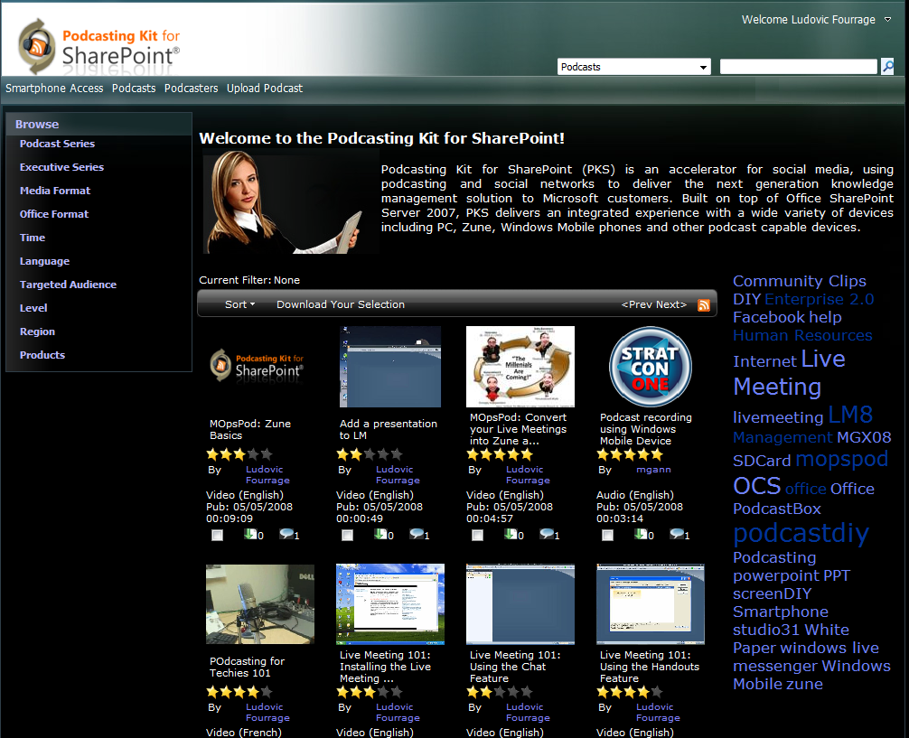
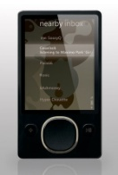
British Telecom
NAVIGATION
  Channels
  Filters
PODCAST SELECTION
  IM Integration
  Presence
  Filters
  Search results
  Subscribe (RSS)
SEARCH
EDITORIAL
  News
  Top podcasts
  Technical updates
  Community Highlights
TAG CLOUD
*not actual British Telecom screen

Slide 25
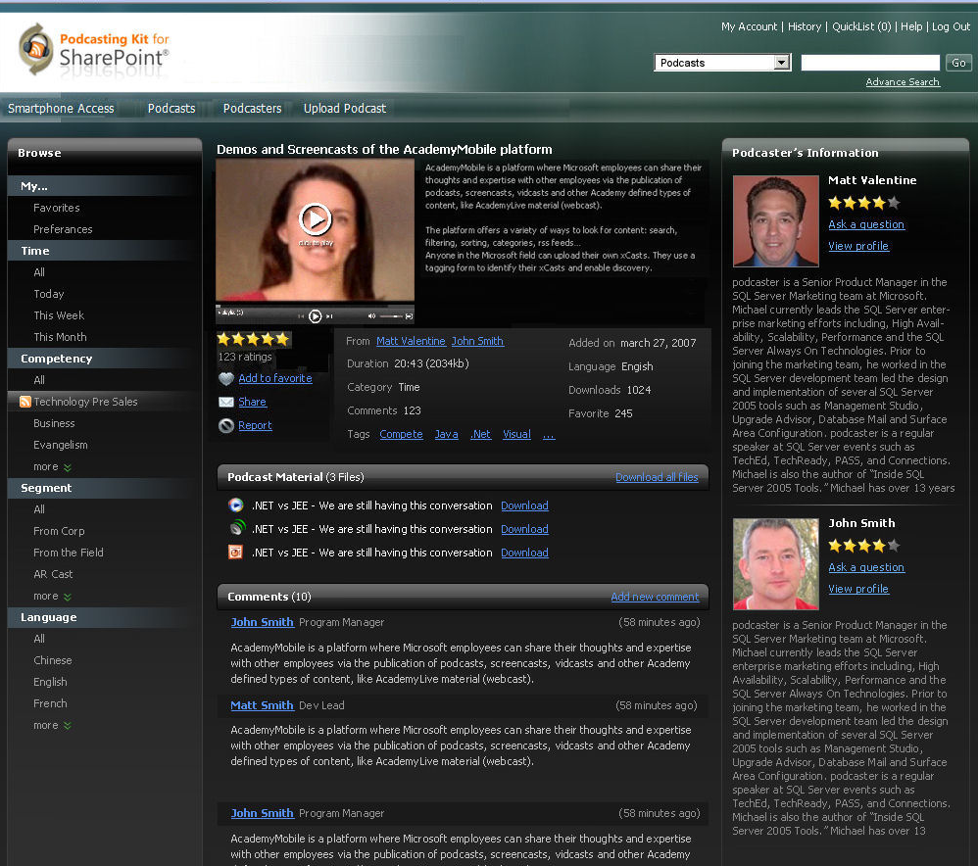

Podcasting Kit for SharePoint
PODCAST DETAILS
  Silverlight playback
  Description
  Rating
  Social actions
  Tags
  Statistics
COLLATERALS
  Transcriptions
  Slides
PODCASTER DETAILS
  Bio
  Picture
  Contact
  IM integration
  Presence
  Average rating
COMMENTS
Andy Jacobs
*not actual British Telecom screen
Notes:
Managing chaos is more than listing nuggets of information, it’s about:
bringing together content creators, contributors, and consumers into one user experience
enhancing the content with rich metadata: going beyond the filename to add a title, a description, keywords (tag cloud), related material…
enabling the audience to contribute to the content by rating and commenting
easy consumption with built-in player (silverlight), download to HD, multi-download / zip feature.

Slide 26
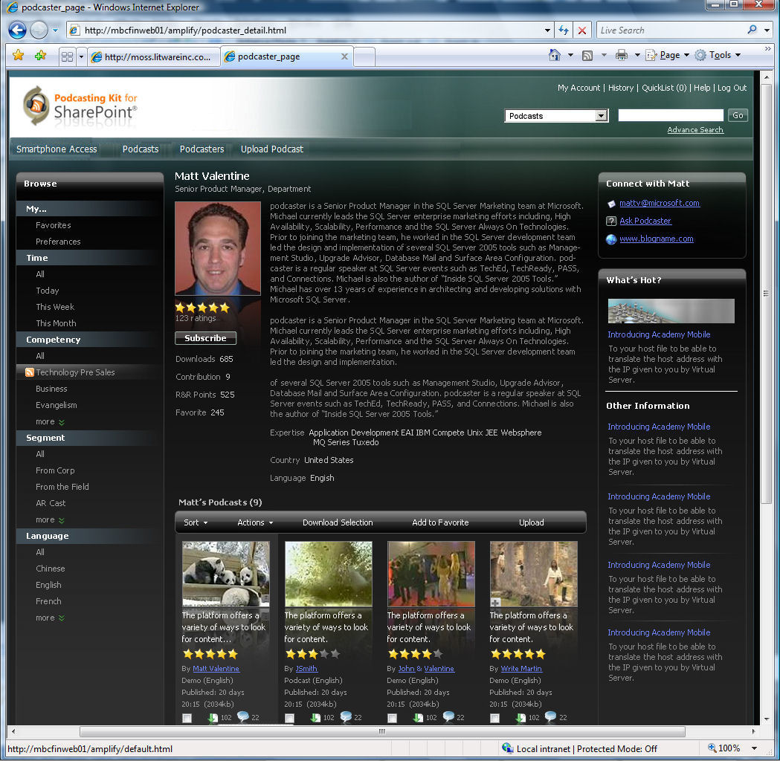
Podcasting Kit for SharePoint
PODCASTER DETAILS
  Bio
  Picture
  Contact
  Presence
  IM Integration
  Average rating
  Statistics
  Points
  RSS
PODCASTS
  Filters
  Subscribe (Podcast RSS)
Andy Jacobs
*not actual British Telecom screen
Notes:
SME network, Subscriptions, IM integration, Reward & Recognition points

Slide 27
Podcasting Kit for SharePoint
Free*
It is an accelerator that will help you save time, money and reduce your risk when deploying social media in your enterprise
It’s FREE, delivered as-is with the source code
It is not supported by Microsoft
It is supported by the community, customers, partners
It is available on the Microsoft open-source web site: www.codeplex.com/pks. Find the list of participating partners at this location as well.
*Requires Microsoft Office SharePoint Portal Server 2007 to run

Slide 28

Introducing

Slide 29
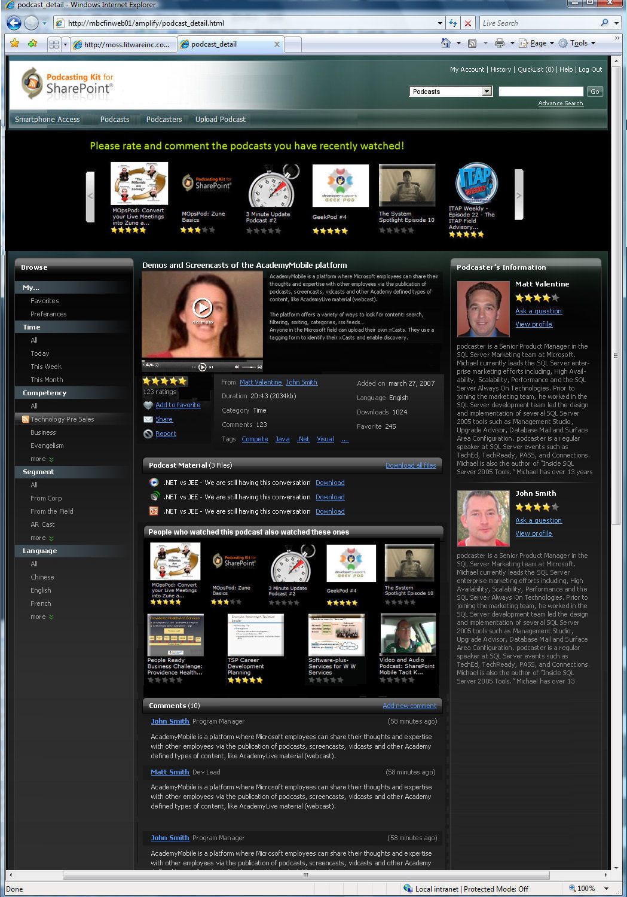
Easily Extensible Platform
Comment and rate your latest downloads
Andy Jacobs

Slide 30
Easily Extensible Platform
People who watched… also watched…
Andy Jacobs

Slide 31
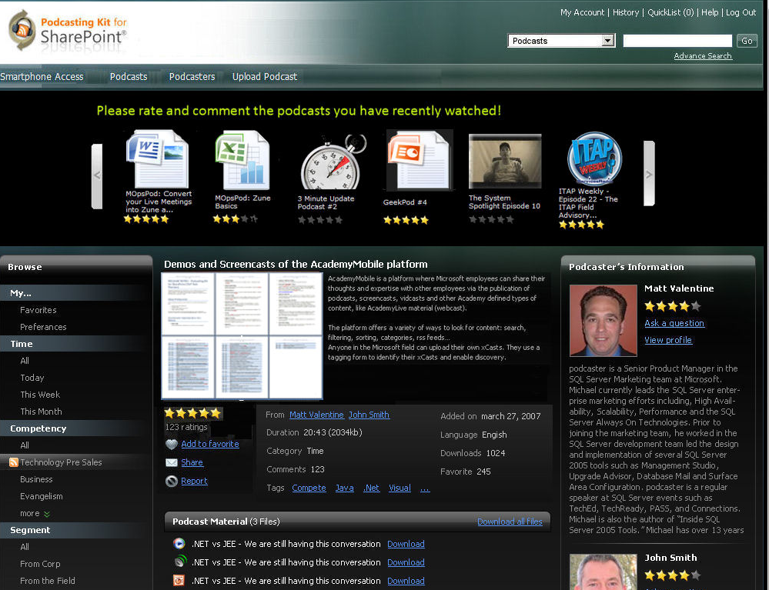
Easily Extensible Platform
What about extending PKS to Office Documents?
Andy Jacobs

Slide 32


Why Bet on Microsoft
Partner Innovation
Collaboration, Portal, BI, Content Management, Search, Processes, UC
Community Kit, Podcasting Kit, Ratings, Tagging, Codeplex
My Sites, Social Networking, Wikis, Blogs, Forums, RSS

Slide 33

Checklist
Prepare
Identify the business case
Build
Provide the right environment
Engage
Allow users to experiment
Measure
Determine business impact and ROI

Slide 34
Resources
Resource | Link
Official SharePoint page | www.sharepoint.com
Official SharePoint blog | http://blogs.msdn.com/sharepoint/
Community Kit for SharePoint | www.codeplex.com/cks
Podcasting Kit for SharePoint | www.codeplex.com/pks
New SharePoint Developers | www.mssharepointdeveloper.com

Slide 35

Alina Fu – alinaf@microsoft.com
Ludovic Fourrage – ludovicf@microsoft.com
Contact INFO:

Slide 36
business models 2.0
Appendix

Slide 37
Learning 2.0
Traditional Learning | Centrally developed or purchased courses
 | Learning segments lasting hours
 | Delivery via PC
 | Often just in case
 | Often compliance driven
 | Train on competencies and knowledge
User/Expert generated content + user ratings | = Learning 2.0
Segments consumable in minutes
Delivery via cell phones, Zunes, etc…
Just in time
More performance driven
Deliver knowledge at point of need
Notes:
Taylorism approach is good for some elements of training and learning (compliance…) but cannot capture the wealth of knowledge and information and make sense of it for the learner.

Slide 38
Education 2.0
Traditional Education | In-person lectures
 | Teacher ↔ Students
 | Curriculum Design
 | Inside the School
 | Compulsory curriculum
 | For GenX (1965-1982)
Online lectures | = Education 2.0
Students ↔ Students
Multimedia Production Design
Outside the School
Complementary Content
For GenY (1983-1997)

Slide 39
Innovation 2.0
Traditional Innovation | Formal invention evaluation
 | Formal Invention description and specifications
 | Centralized in R&D and Labs
 | Core team inspiration and brainstorming
 | Development Status Reports
 | Traditional marketing
Real-time invention Evaluation | = Innovation 2.0
Lively pitch of the invention to investors, stakeholders…
Opened MarketPlace for all employees
Company wide Brainstorming
Audio and Video demo of progress made
Digital Marketing

Slide 40
Human Resources 2.0
Traditional HR | Organization-based networks
 | 1:1 Career Development, Mentorship
 | Limited Knowledge Management
 | Opaque Expertise Management
 | Print-based Culture and Requirement
 | Reward-based recognition
Affinity based networks | = Human Resources 2.0
1:Many Career Development, Mentorship
Knowledge Management 2.0
Open and network based expertise management
Vibrant and Multimedia culture and recruitment
Ego-based recognition

Slide 41
Marketing & Communications 2.0
Traditional MarCom | Com: eMails, Newsletters
 | Com: Corporate Brand
 | Marketing: Survey-based customer feedback
 | Marketing: Yearly planned Bill of Material
 | Marketing: TV, Paper, Mail channels
 | Marketing: Mass Marketing
Audio, Video | = MarCom 2.0 (Digital Marketing)
Consumer look & feel
Real-time commenting, ratings, popularity data
Real-time creation of content and Distribution
Internet, Video
Viral distribution

Slide 42
Customer Support 2.0
Traditional Customer Support | Written articles
 | Created by product teams
 | Support Service
 | Escalation process
 | Corporate driven
 | Survey based feedback
Visual How-To + Discussions | = Customer Support 2.0
User-generated
Self-Support
Ad-hoc process
Community driven
Real-time feedback
Notes:
Your customers helping one another via visual “how-to’s”

